Slide 1
Restoration Fundraising

Slide 2
Question One
For the Confederated Tribes of Grand Ronde to regain their status as a federally recognized tribe, there were many steps they had to go through along the way. To raise money, one fundraiser they held often was a bake sale. If 20 people donated a baked good (cake, cookies, brownies, etc.) and every baked good was purchased for $5, how much money was made during that fundraiser?

Slide 3
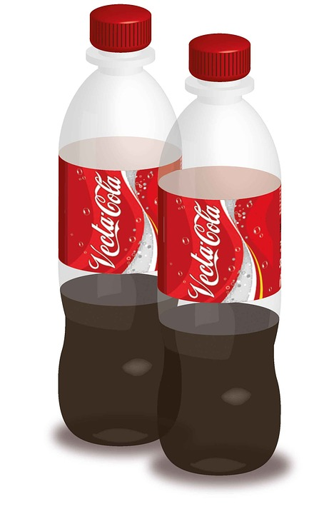
Question Two
Bottle/Can returns were another fundraiser often used. People of Grand Ronde would save up their cans and bottles for the Restoration Committee to collect and deposit for money. If the Committee had a goal to raise $50 by returning cans and bottles, and each can/bottle was worth ¢5, how many cans/bottles would they need to turn in?

Slide 4
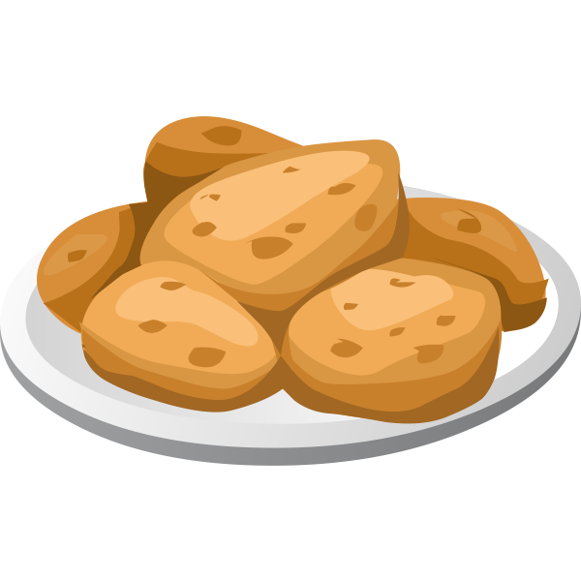
Question Three
Another fundraiser the people of Grand Ronde often held were frybread sales. These sales usually included selling pieces of frybread covered with berry jam along the highway. One day while out selling frybread, Mrs. Leno was able to sell 16 pieces of frybread! If every piece of frybread cost $3, how much money was Mrs. Leno able to raise that day?

