Slide 1

“The weather still continues pleasant. It was found necessary to have more teams than at first contemplated. I accordingly proceeded to Jacksonville for that purpose, and also to provide some articles, such as clothing and blankets to add to the comfort of the Indians, although the weather is sett down as pleasant. It certainly would be regarded as such, especially at this season of the year, however the nights are quite frosty and the mornings cool, sufficiently so, to render it necessary that they should be provided with Tents, Blankets, shoes & such necessities as would tend to promote their comfort while on their journey which being procured the day was spent in distributing the articles among them. Also two additional teams were secured to convey the sick, aged, and infirm. Our teams now number eight which I fear will not be sufficient. Thirty four Indians are disabled from traveling by reason of Sickness aside from the aged and infirm, who will as a matter of course have to be hauled.”
Notes:
Q: Who do you think is writing this journal entry? (U.S. Federal Agent George H. Ambrose)
Q: What event do you think he is writing about? (The Oregon Trail of Tears)
Q: What are some of the key words/phrases in this entry that provide us with context? (“Jacksonville”-location, “Indians”-people, “tents, blankets, shoes”-supplies, “journey”-travel)

Slide 2

The Grand Ronde Trail of Tears
Exploring the 1856 Diary of Agent George Ambrose

Slide 3

Who was Agent George H. Ambrose?
Background
Emigrated to Oregon, along with his wife Ellen Frances, in 1850
They filed a Donation Land Claim Act and settled in Jackson County in 1852
Took over administration of the Rogue Valley Indian Agency in 1853
February 1856 - Following the national policy of removal and relocation, Ambrose set in place the plan of Superintendent Joel Palmer directed the removal of the surviving Native Peoples of the Rogue River Valley
Journal
Documents the journey northward via the Applegate Trail
Fact-centered and displays little emotions
Shares accounts of inadequate supplies, weather, fear, and deaths
Describes the pursuit of self-styled executioner Timeleon Love, who was chasing the party in attempt to execute the Native Peoples

Slide 4
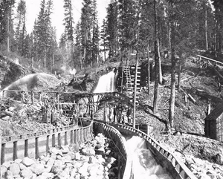
Timeline: 1846-1852
1846-1852
Flood of emigrants via the Applegate Trail into Native homelands*
Discovery of gold on Jackson Creek in early 1852 brought more settlers
Miners and pioneers settled in the region as a result of the Oregon Donation Land Claim Act of 1850
Results: Ecological disruption and destruction of resources needed for Native Peoples’ survival
Building of fences**
Suppression of Indian fire ecology necessary for hunting/gathering
Farm animals feeding on traditional plants
Increased mud and river disruption, causing detrimental impacts to salmon and eel runs as well as fishing grounds
Settlers’ use of firearms to hunt animals***
19th Century Gold Mine on Jackson Creek
Notes:
*Q: What major event in U.S./Oregon history was occurring at this time? (Oregon Trail)
**Q: What do you think was the purpose of these fences? Keeping animals in, keeping Native Americans out, division of land?
***At this time it was illegal for Native Americans to possess a firearm or purchase ammunition

Slide 5
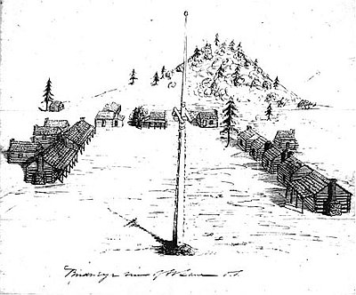
Timeline: 1853-1856
1853-1856
1853 - Bureau of Indian Affairs (BIA) negotiated treaties with the Native Peoples of the Rogue River Valley and created the temporary Table Rock Reservation
  Fraction of their original territory
  Lacked resources
  Soldiers at Fort Lane proved inadequate to stop trespassers and self-styled “exterminators” who murdered and massacred Native Peoples.
Disease: Along with the removal of land and resources, Native Peoples were also exposed to a plethora of diseases during this removal and relocation
  Measles, influenza, etc.
  Killed Native Peoples by the dozen and in some cases, wiped out entire villages
October 1855: Table Rock Reservation attacked by “exterminators” from the Jacksonville Mining Camp. This sparks the beginning of the Rogue River Indian War of 1855-1856
  Loss of many lives and the fleeing of many able-bodied Native Americans west into the canyon
Sketch of Fort Lane

Slide 6
The Journey
The Rogue River and Chasta Tribes were the first to be removed (ɬaq) from their aboriginal lands. They were joined by members of other Tribes and bands as the march passed other tribal homelands.
Native people were gathered up near Ft. Lane, at the base of Table Rock (near present day Medford) and forced to march during the wintertime (khul-iliʔi) months beginning February 23 through March 25, 1856, to the Grand Ronde (shawash-iliʔi) Indian Reservation.
TIMELINE:
February 23, 1856: 325 Native Americans left the Table Rock Reservation.
March 25, 1856: Arrived at the Grand Ronde Reservation around 4PM.
33 days (sans) 263 miles
8 deaths (chaku-hilu) 8 births (t’ɬap-tǝnas)
Notes:
Chinuk Words:
removed - ɬaq
Grand Ronde - shawash-iliʔi
wintertime - k^{h}ul-iliʔi
days (sans)
to die (chaku-hilu)
birth (t’ɬap-tǝnas)

Slide 7
February 23rd Saturday (1856)
“The weather still continues pleasant. It was found necessary to have more teams than at first contemplated. I accordingly proceeded to Jacksonville for that purpose, and also to provide some articles, such as clothing and blankets to add to the comfort of the Indians, although the weather is sett down as pleasant. It certainly would be regarded as such, especially at this season of the year, however the nights are quite frosty and the mornings cool, sufficiently so, to render it necessary that they should be provided with Tents, Blankets, shoes & such necessities as would tend to promote their comfort while on their journey which being procured the day was spent in distributing the articles among them. Also two additional teams were secured to convey the sick, aged, and infirm. Our teams now number eight which I fear will not be sufficient. Thirty four Indians are disabled from traveling by reason of Sickness aside from the aged and infirm, who will as a matter of course have to be hauled.”
Notes:
Deep Dive:
Green: discussion of need for additional teams - Why do you think Ambrose was so concerned about the need for additional teams of U.S. Government soldiers? What were the jobs of these soldiers?
Purple: are these items that the Tribes were familiar with?

Slide 8
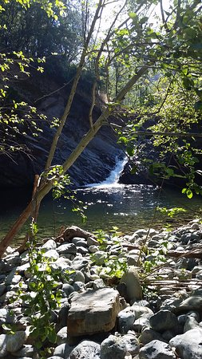
February 29th Thursday (1856)
“Frosty and cool again this morning. While about preparing to leave camp some person killed an Indian who had wandered off some distance from camp in search of his horse which had strayed off during the night, which had caused some excitement among the Indians as it went to prove the statement previously made by some evil disposed persons, to wit: that they would be killed by the way. We learned this morning that a party of evil disposed persons have gone in advance of us, as os supposed to annoy us, or kill some friendly Indians. A messenger was immediately dispatched to Capt. Smith at Fort Lane for additional force to escort us to thro[ugh] the Canyon if it should be found necessary. We also learned that an individual by the name of Timeleon Love was the person who killed the Indian this morning and that he composes of the party that had just passed. We drove today a distance of eleven miles and encamped on the bank of Jump Off Jo[e] Creek where we will most probably remain till the arrival of Capt. Smith.”
2017: Jump Off Joe Creek
Notes:
Deep Dive:
Green: what does he mean by “excitement”? (fear)
Purple: who are the “evil disposed persons”? (the self-styled executioners aiming to execute the Native Peoples)
Q: Why do you think Ambrose called-in additional resources
(Possible Answers: to protect the Native peoples because he cares for them as human-beings, to protect the Native peoples to ensure he can fulfill his job requirements, to protect himself and the other teams of Federal Agents, etc.)

Slide 9
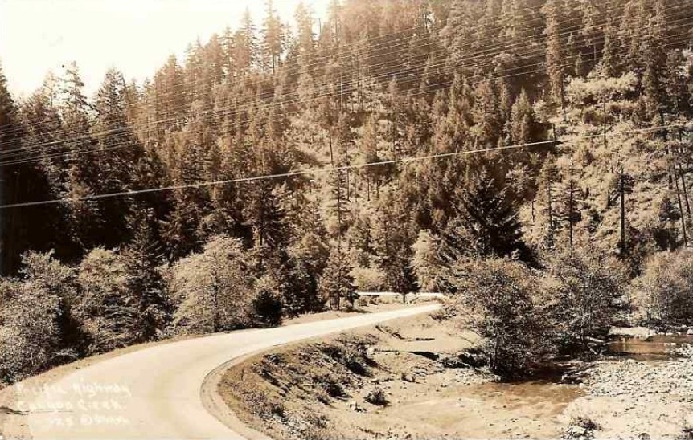
March 3rd & March 5th (Monday & Wednesday)
March 5th
“The Indians remained in camp today at the mouth of Canyon creek awaiting the arrival of the wagons about three or four o’clock in the evening they made their appearance. The cattle very much jaded & tired as no forage could be had. I secured the best pasture I could find and turned them in that. An Indian girl died this evening. We are now a distance of eleven miles from our camp of the evening of the third being occupied two days in making it. Mr. Love who still continues to follow us was arrested and put under guard.”
March 3rd
“The mornings still continue quite cool & frosty; our rout[e] lay almost directly North over somewhat better ground than for two days previous. Our cattle was jaded considerable by our continuous marches, without forage or grass, neither of which could be procured. We drove a distance of seven miles & encamped just within the mouth of the canyon.”
Entering the Canyon from the north, circa 1930
Notes:
Q: Who/what does Ambrose seem to share the most information about? (Weather & Cattle)
Q: In the entry from March 5th, Ambrose very briefly mentions that death of a Native girl. What does this brief statement tell us? How does it make you feel (or think) about Ambrose? (He seems to care primarily for the animals and other U.S. Agents on the journey but very little about the Native Americans he is transporting)

Slide 10
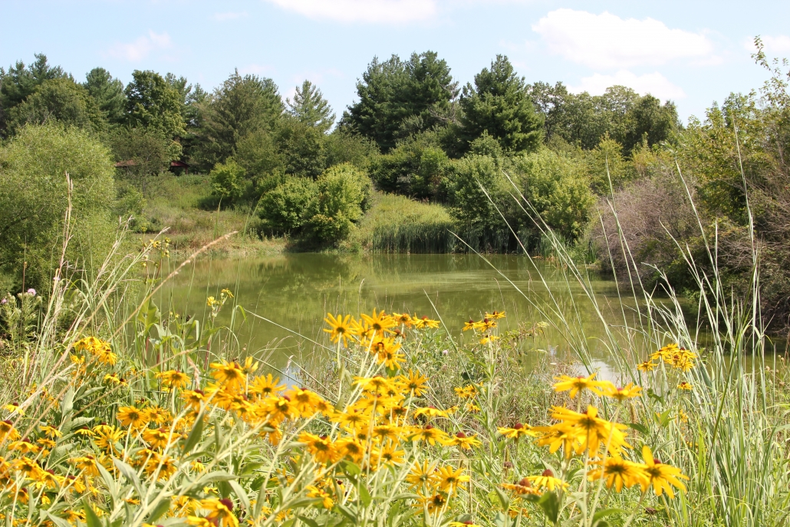
March 7th Friday
“The weather still continued cool and frosty of nights and pleasant thru the day. Our road today hilly & in places quite rocky. An Indian woman died this morning & the number of sick increasing. It was found necessary to hire or buy another team. I soon procured one & continued our march. We drove today a distance of ten miles & encamped in Round Prairie on the South Umpqua yet.”
Round Prairie - Douglas County, Oregon

Slide 11
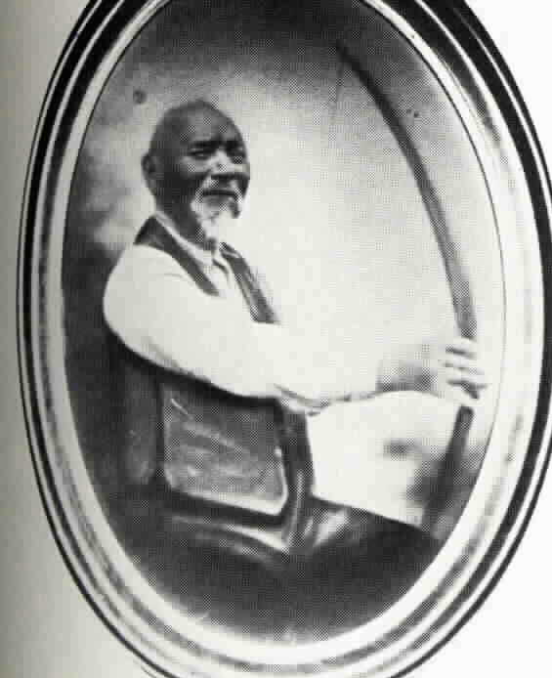
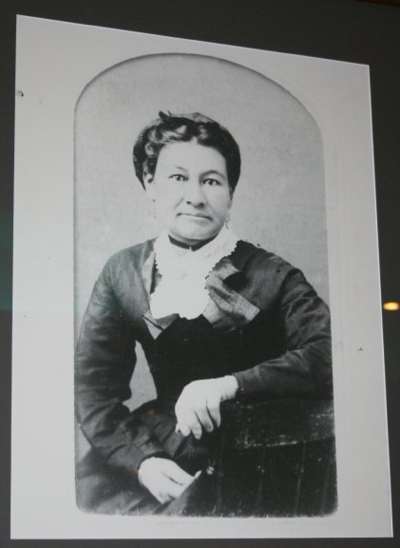
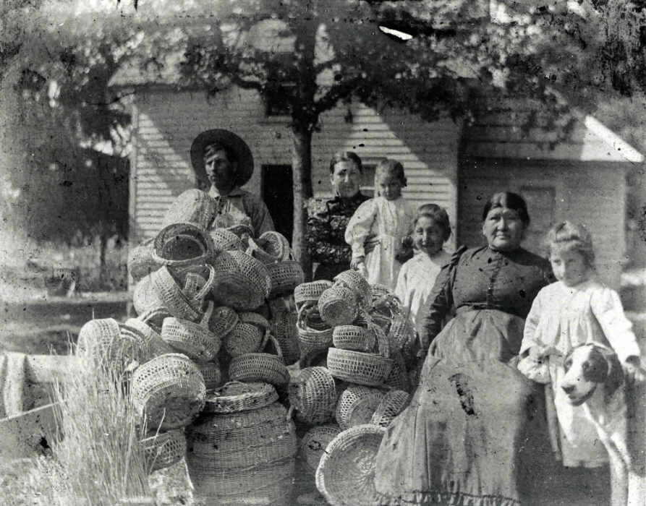
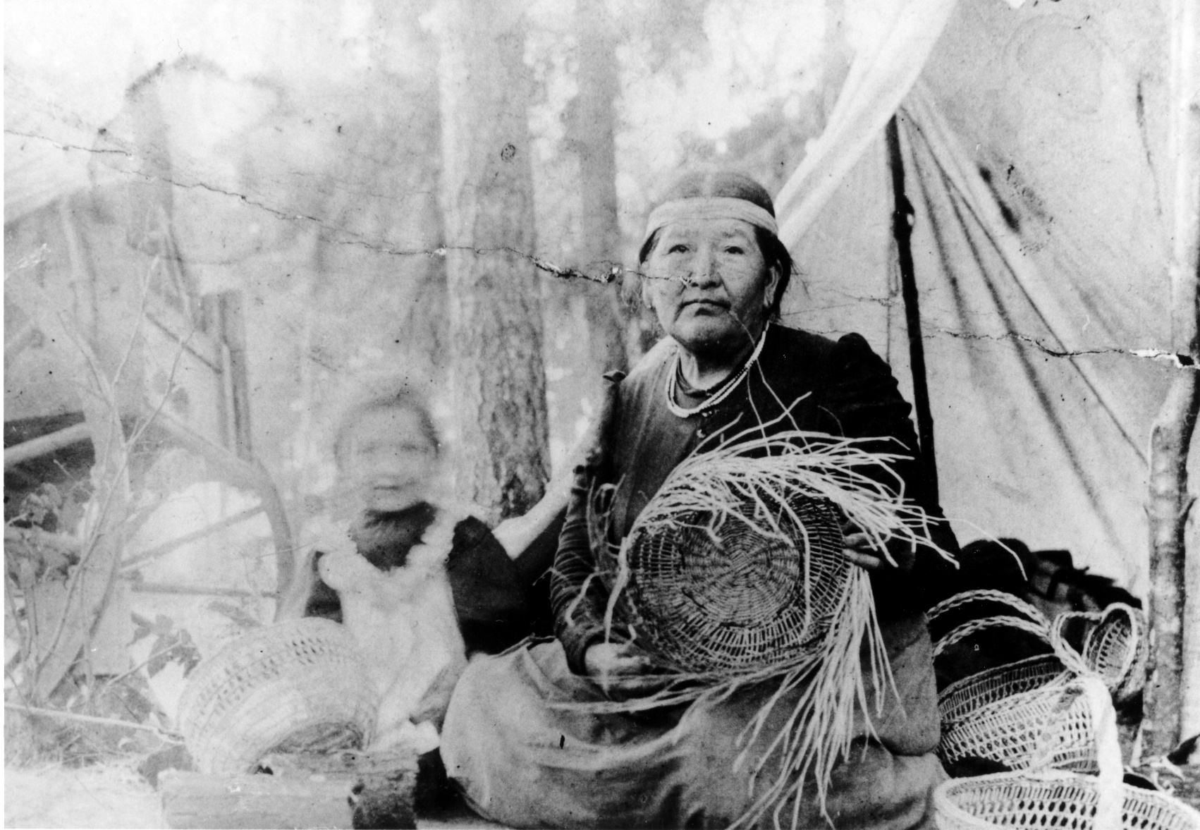
March 12th - March 24th
Weather
Lost cattle
Conditions of trail
Brief mentions of death
Although not mentioned often by Ambrose, the Native Peoples on the trail faced illness, exhaustion, hunger, and physical injury.
“It almost makes me shed tears to listen to them as they totter along,” observed Lt. E.O.C. Ord who witnessed one of these removals.
Notes:
Faces of the Trail:
Men, Women, & Children traveled the 33 days by foot or horse/wagon.
Some of these individuals include:
Gertrude Mercier and Martha Jane Sands (top left image)
The Hudson Family (bottom left image)
Solomon Riggs (center)
Jenny Riggs (right image)

Slide 12
Final Entry: March 25th Tuesday
“Clear & pleasant we got an early start this morning and after driving hard all day reach the reservation about four o’clock in the evening after driving a distance of sixteen miles, so ends my journey & journal after a period of thirty three days in which time we traveled a distance of two hundred & sixty miles started with three hundred and ninety-five Indians. Eight deaths and eight births leaving the number the same as when we started.”
Notes:
This is the final entry in George Ambrose’s journal. He summarizes the miles traveled and the number of births/deaths.
Q: After reading through some of Ambrose’s journal entries, what questions do you still have?
Q: What is missing from Ambrose’s journal? (The experience of the Native Peoples on the Trail of Tears)

Slide 13
“Left behind were the bones of parents, grandparents, and ancestors, ages-old villages and fisheries, and a way of life well-tuned to the rhythms of a beautiful land.”
Notes:
This is a quote from an article written by Stephen Dow Beckham. It is part of a larger paragraph stating:
“The Ambrose diary, which follows, documents to closing chapter on countless millennia of Indian tenure in the Rogue River Valley. Left behind were the bones of parents, grandparents, and ancestors, ages-old villages and fisheries, and a way of life well-tuned to the rhythms of a beautiful land.”
Q: How does this quote change the way you think about the removal of Native Peoples?

Slide 14
Activity
The information provided about the Oregon Trail of Tears comes almost entirely from the viewpoint of the White United States Federal Agents escorting the Native Peoples from the Table Rock Reservation to the Grand Ronde Reservation.
What we are missing is the Native American perspective. Based on what you have learned about the trail and the hardships endured by the Native Peoples on the journey, write a journal entry map from the Native American perspective. Use the Trail of Tears map on Slide 6 as an example.

Slide 15
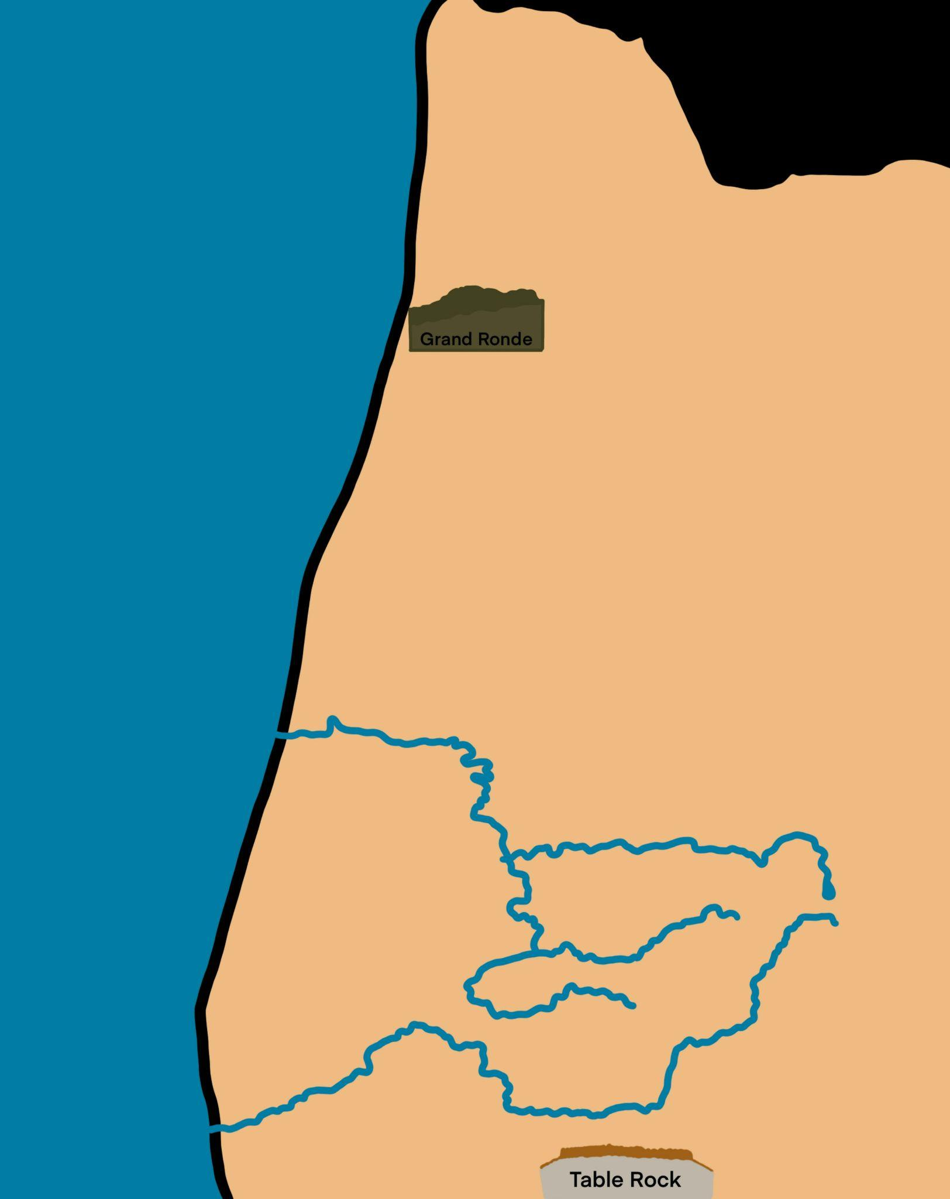
What to Include:
Route
Important Landmarks
Important Cities
8 Journal Entries from the Native American perspective
Optional: Small symbols to identify different events along the trail

Slide 16

EXTENSION:
Explore Ambrose’s Journal Entries
Visit the website: https://www.grandronde.org/history-culture/
OR
Scan the QR Code on this page
Scroll down to “Our Land”
Use the slider to read journal entries from dates along the trail

