Slide 1
Traditional Foods
- The Confederated Tribes of Grand Ronde -

Slide 2
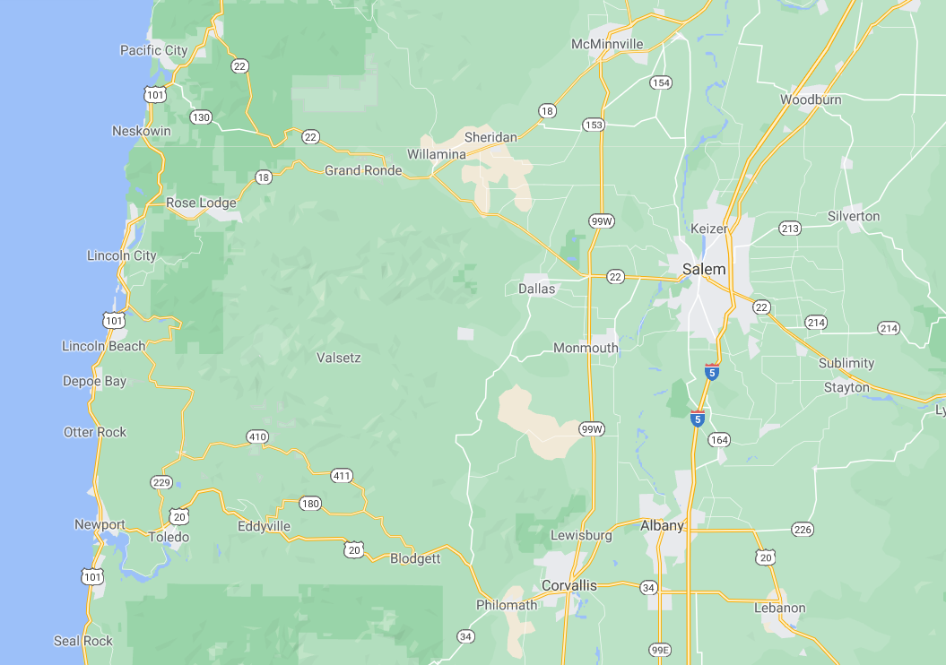
Where is Grand Ronde?
Notes:
Review the map of Oregon with students.
Can they find where they are located on the map?
If time allows, use a maps search engine (i.e. Google Maps) to determine how far your school is from the Confederated Tribes of Grand Ronde.

Slide 3
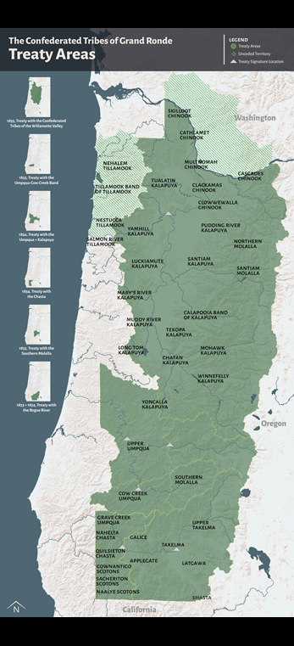
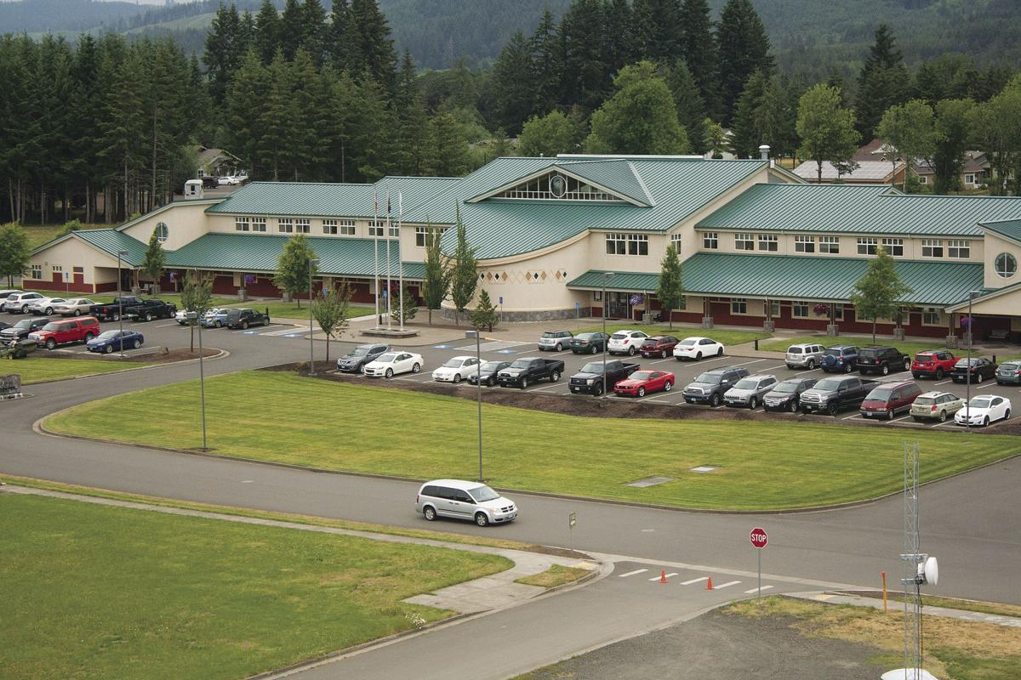
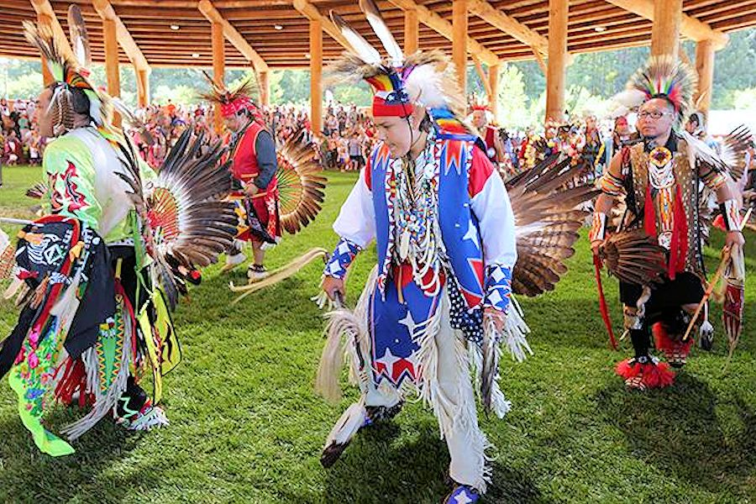
What is the Confederated Tribes of Grand Ronde?
Often referred to as CTGR
One of the nine federally recognized Native American tribes in Oregon.
Made up of more than 27 different bands and tribes across Oregon and brought together on the reservation in Grand Ronde, Oregon.
They have a unique culture, language and set of traditions practiced by their people.
The Grand Ronde government, Tribal Council and main campus is currently located in Grand Ronde, Oregon.
There are over 5,500 tribal member across the world.
CTGR Governance Building
CTGR Pow Wow Dancers

Slide 4
Traditional Foods for CTGR
Traditional Foods: also called “First Foods”, are the plants and animals that the Tribe has lived off of for thousands of years, pre-contact with European influences. They are staples of native culture, spirituality, medicine and overall well-being. Many traditional foods are still enjoyed today by many members of tribes across the country.
There is often a unique strategy to harvesting plants and animals in Native American tribes. Native peoples always thank the earth and the plant/animal for the sacrifice it is making to feed our people.

Slide 5
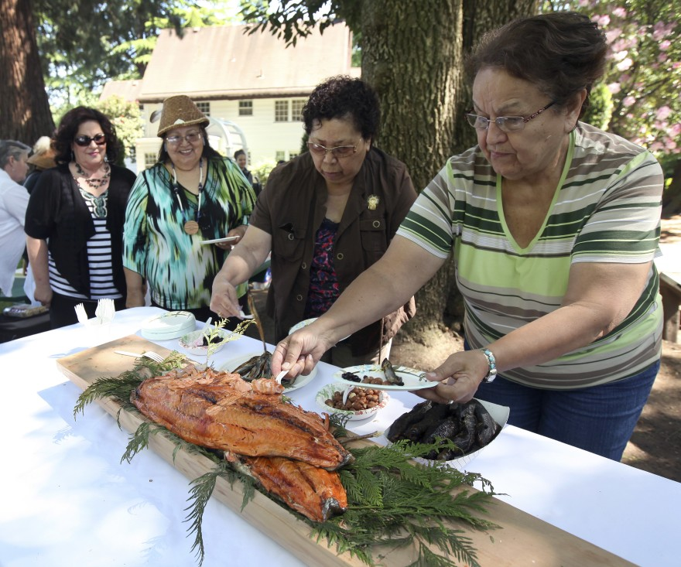
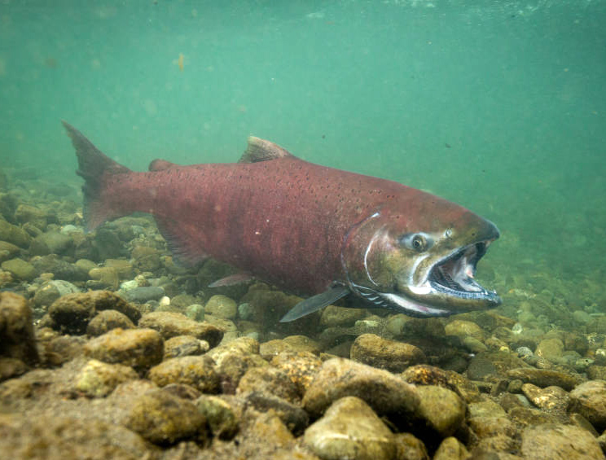
Salmon
kʼwənat
Salmon is harvested from the local rivers and streams, including the Willamette River at Willamette Falls.
Salmon are often caught using dip nets or hoop nets.
Salmon are extremely sacred to Native peoples. A ceremony is held each year, the First Fish Ceremony, to honor the relationship between salmon and the Native peoples.

Slide 6
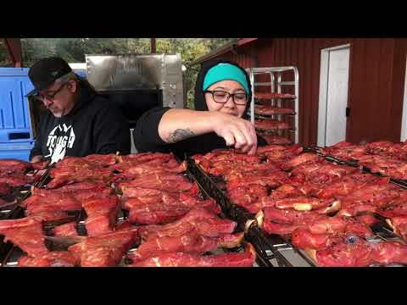
The Laws with Salmon
Preparing Salmon
During the CTGR First Salmon Ceremony -
Cultural Outreach Coordinator Bobby Mercier invited the women and young girls to come up and symbolically tap the fish on the head with a fish club. When the women finished their line, Tribal Elder Greg Archuleta invited the men and young boys to do the same. As many as 50 people attended the ceremony.
Mercier said to those gathered that a longstanding agreement exists between Tribal peoples and salmon.
“What we did was recognize the laws we have between us and the salmon,” said Mercier. “The agreement we have between us and the salmon is that he would forever feed us as long as we did not forget to sing to him and to honor him. By each one of us tapping that fish with those clubs it is each one of us saying to that fish that we remember that. We won’t forget that. We won’t forget that law we have between each other.”
Mercier said when the singing stops, the salmon will cease returning.
nsayka munk-smuk kʰapa kʼwənat (We Smoke Salmon)

Slide 7
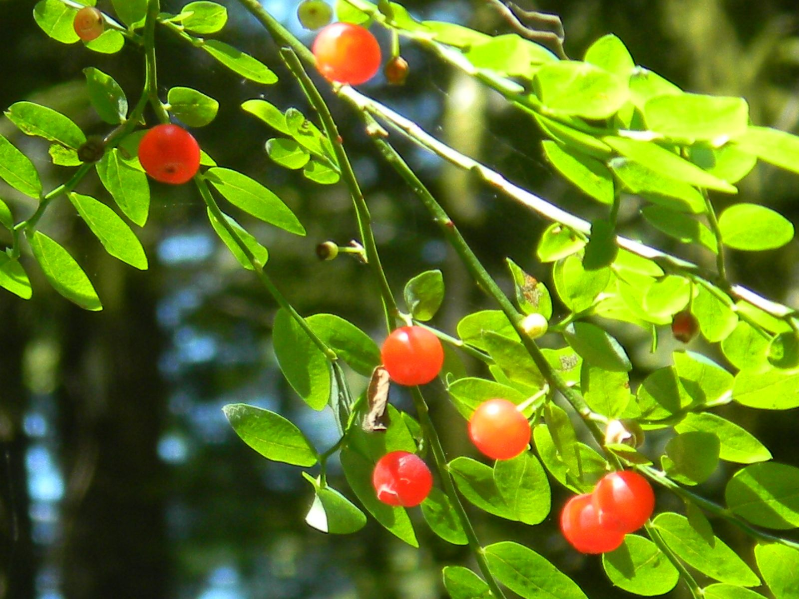
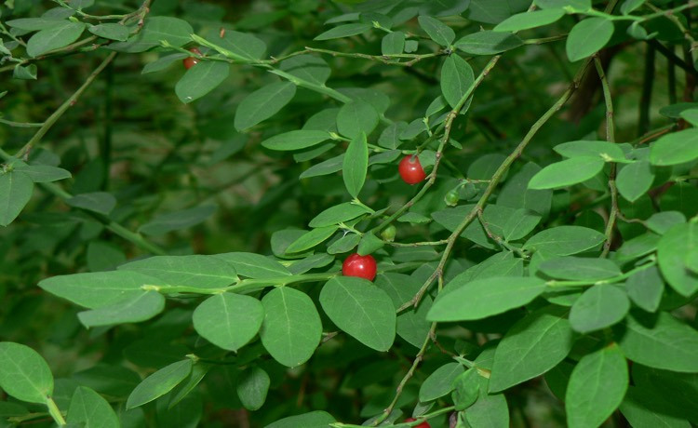
Huckleberries
shat-ulali
Huckleberries can be found throughout the Pacific Northwest and can be a variety of colors
Fresh huckleberries are eaten in-season, but most of the harvest of huckleberries is dried to provide food throughout the year. Historically, Native peoples used dried huckleberries to provide nourishment throughout the winter, mixing them with meats into “pemmican”—a combination of ground meat, fat and dried berries.
Huckleberry plants, including the leaves, stems, flowers, and roots can be used for medicinal purposes. These plant parts can be steeped in hot water to produce teas or infusions. They were often used for purification of the blood, treating colic in infants, inducing labor, and as a diuretic.

Slide 8
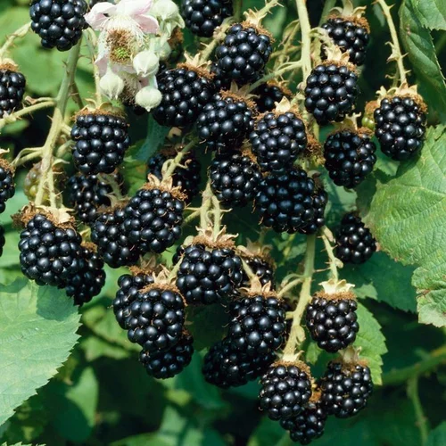
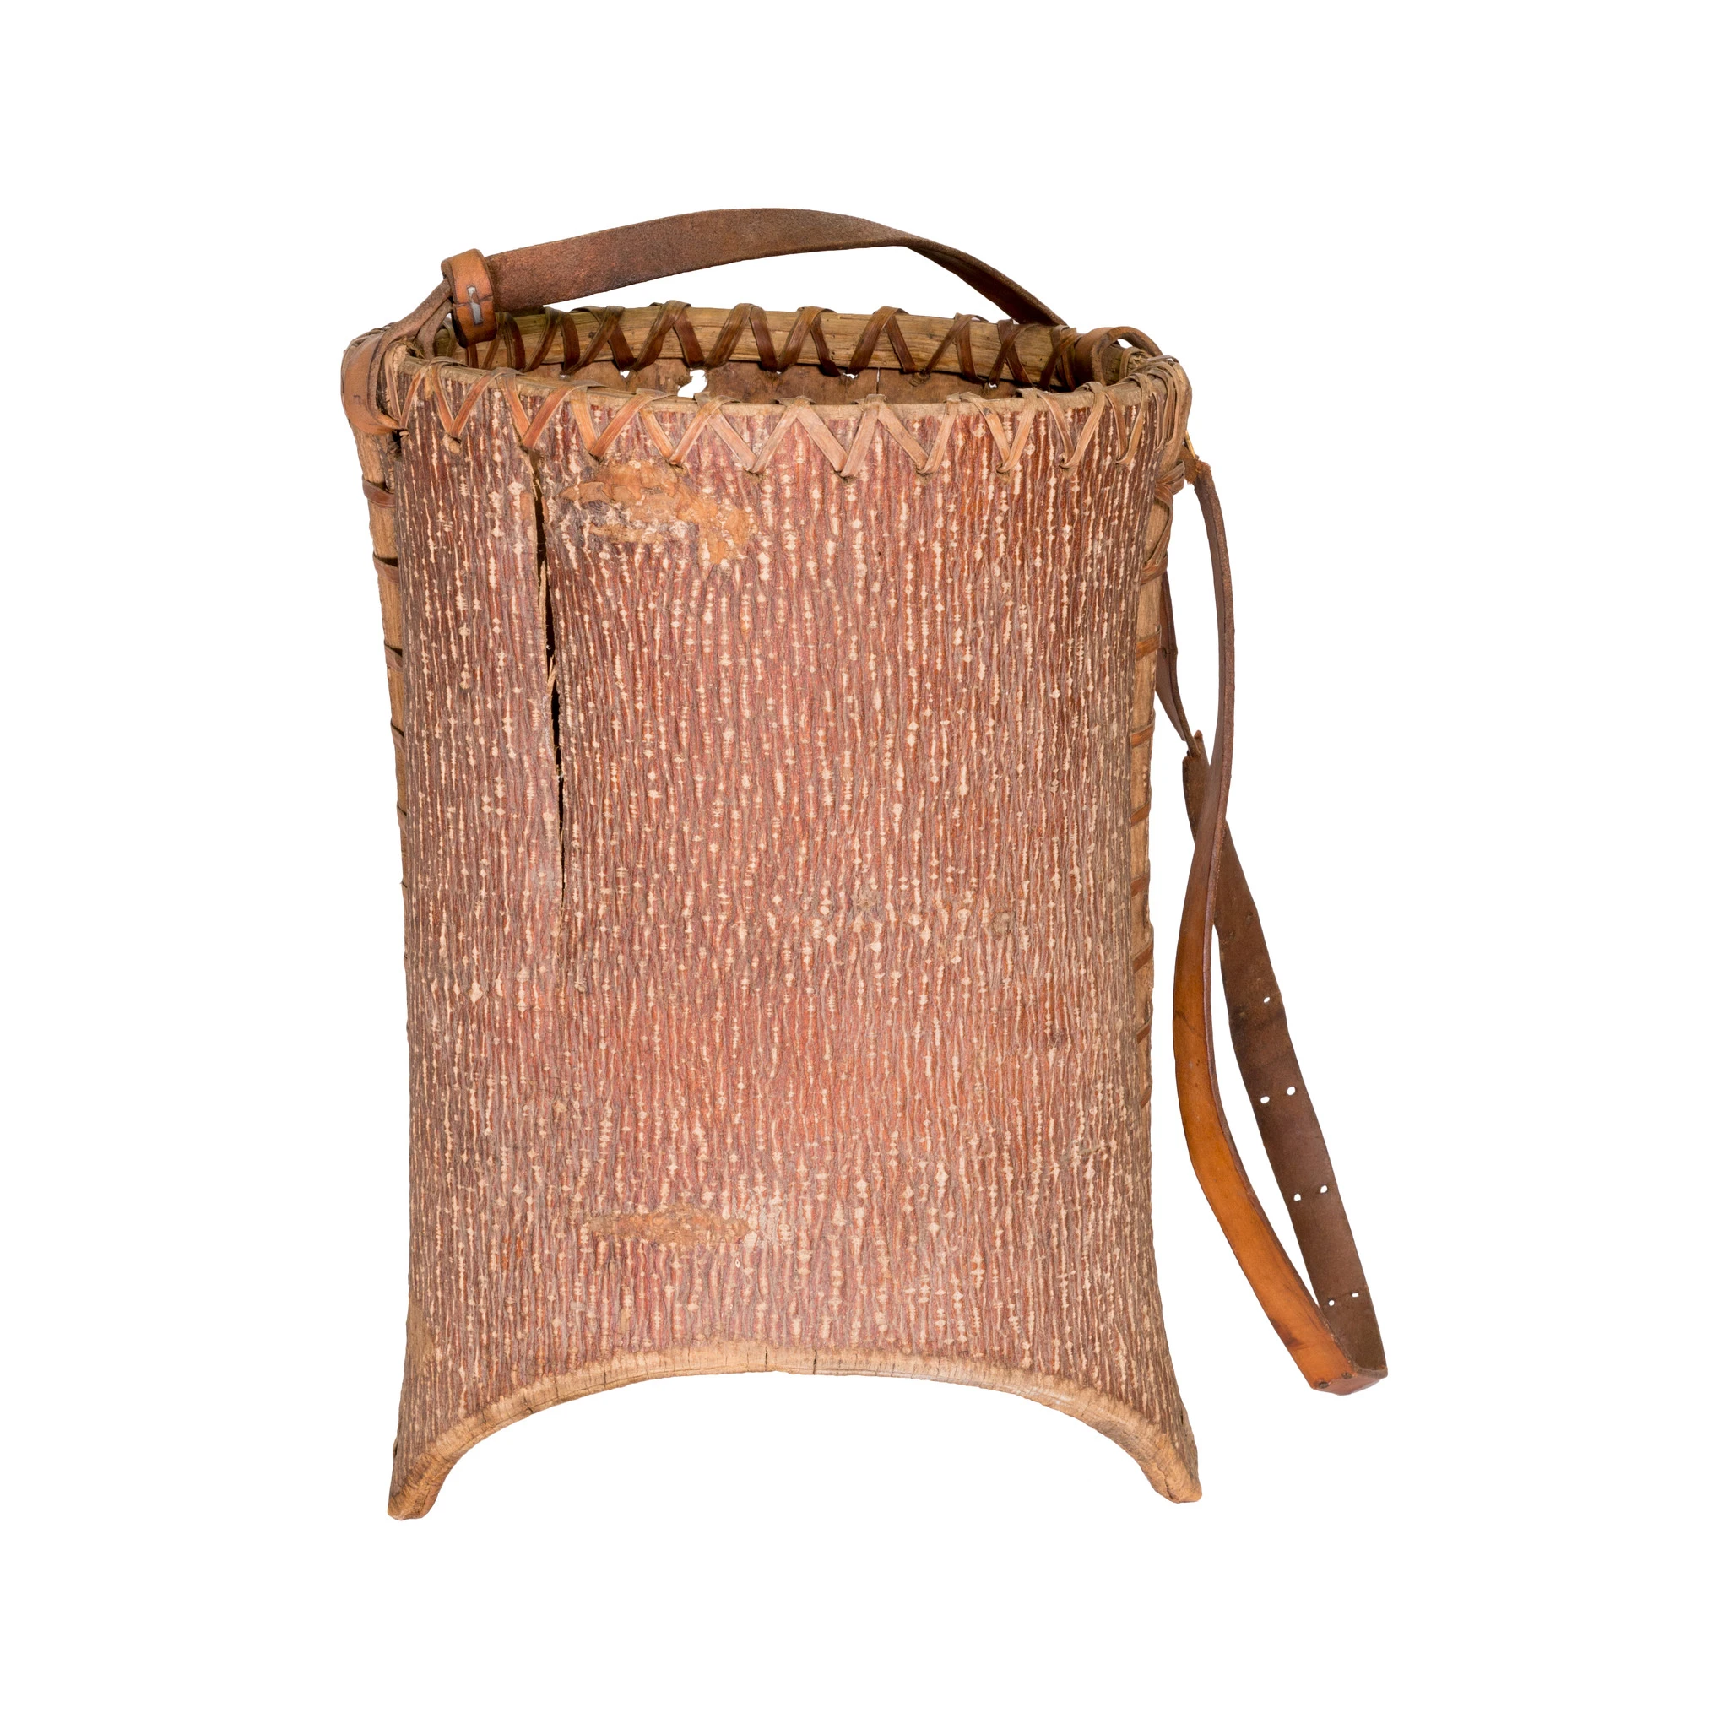
Blackberries
ɬikʰəmuks
Ripe berries can be eaten fresh, ground with wild game meat to make pemmican cakes, or dried and stored for later.
As medicine, blackberries can be used in the treatment of many ailments, including dysentery, diarrhea, whooping cough, toothache, anemia, sore throat, and minor bleeding.
An infusion of the roots, sometimes mixed with blackberry leaves, is taken to treat diarrhea, rheumatism, colds, and cough.
Historically, blackberries were often gathered in solid straight baskets (seen right) to prevent being smashed.

Slide 9
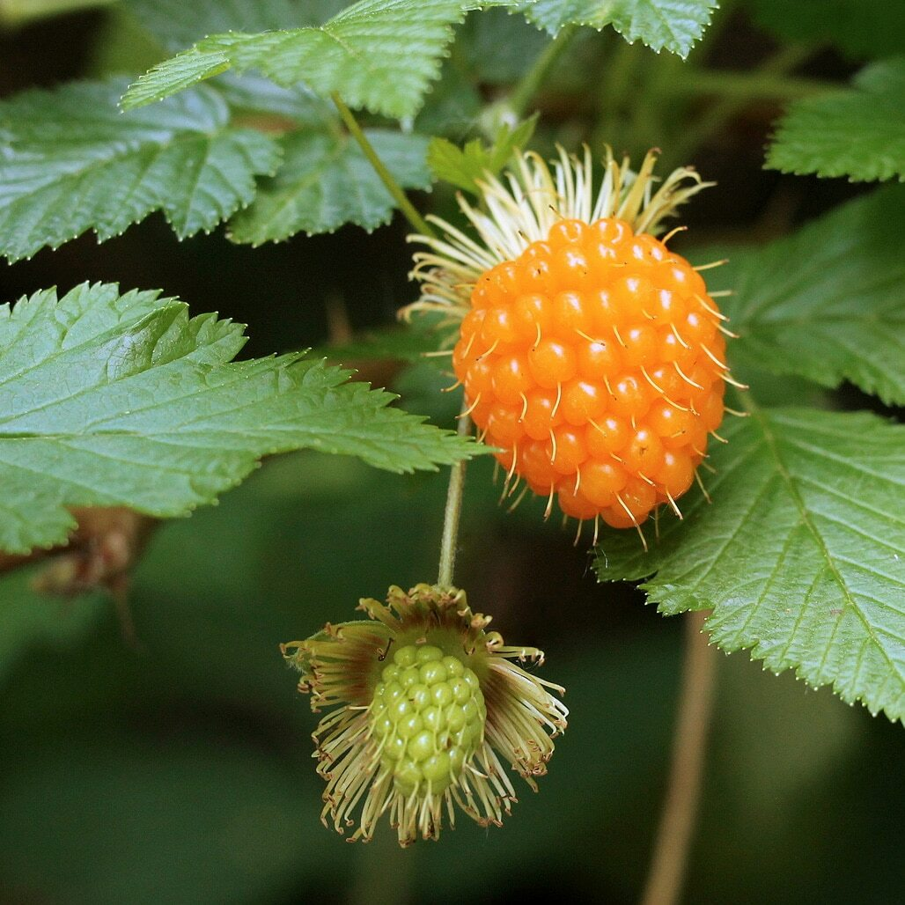
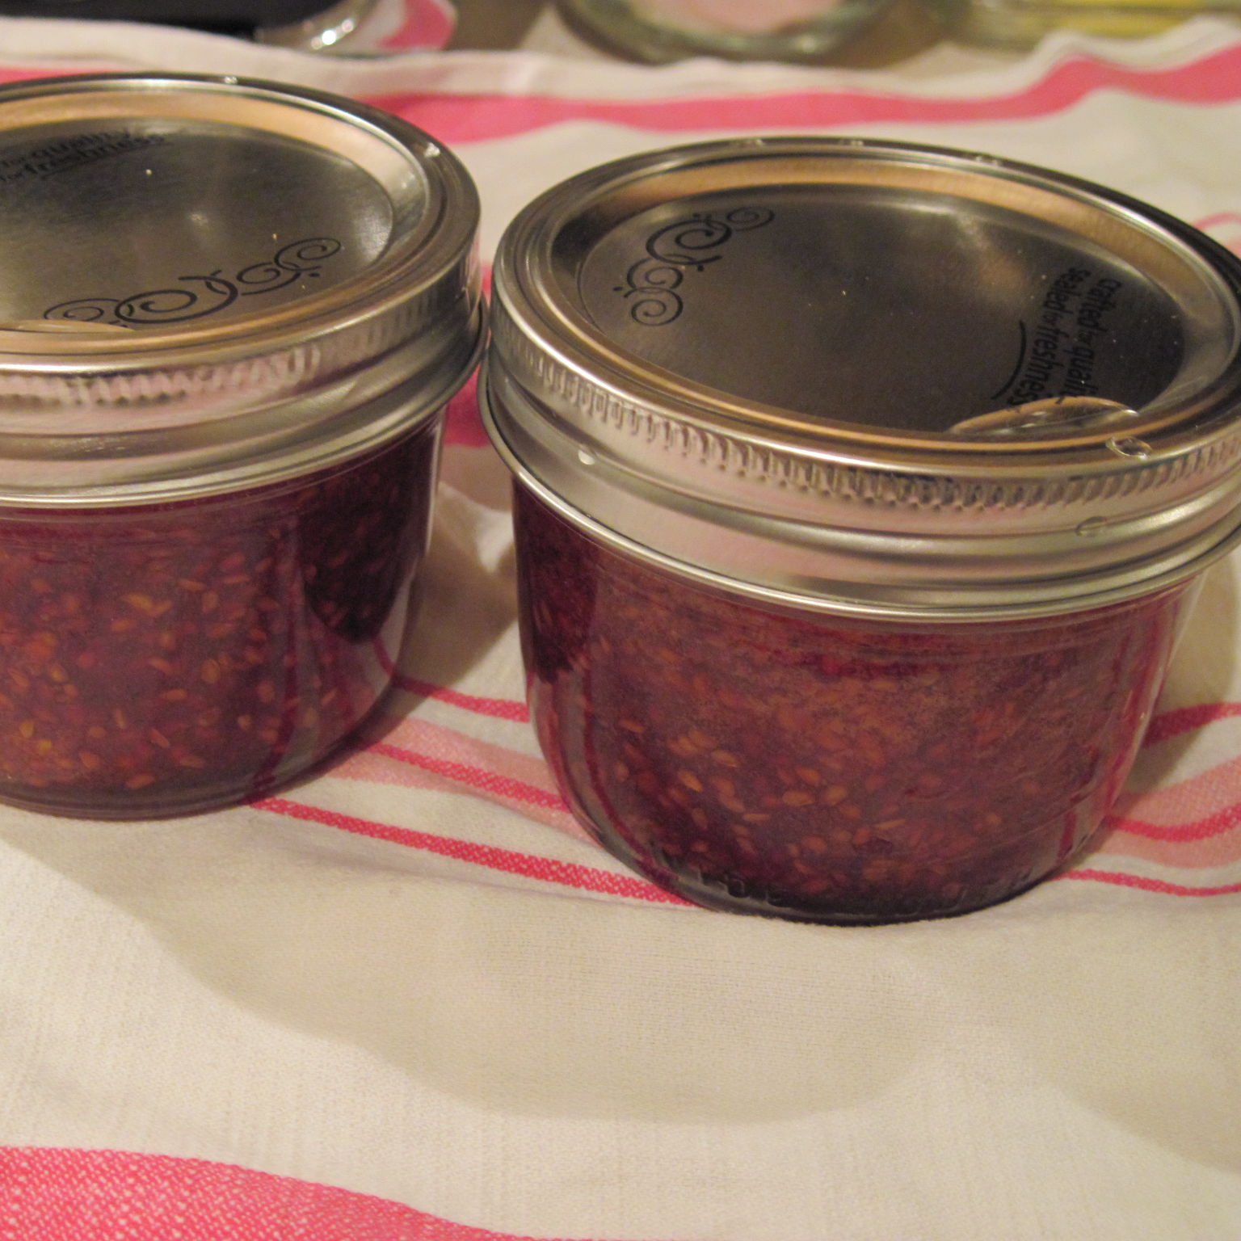
Salmon Berries
samən-ulali
Ripe berries are eaten fresh, ground with salmon meat or eggs, dried, or made into jam.
As medicine, salmon berries can be used to treat anemia, toothaches, promote weight gain, fix stomach problems, reduce the pains of flesh injuries, and ease labor pains
Historically, women were responsible for gathering salmon berries but today, many members of tribes work together to gather the berries.

Slide 10
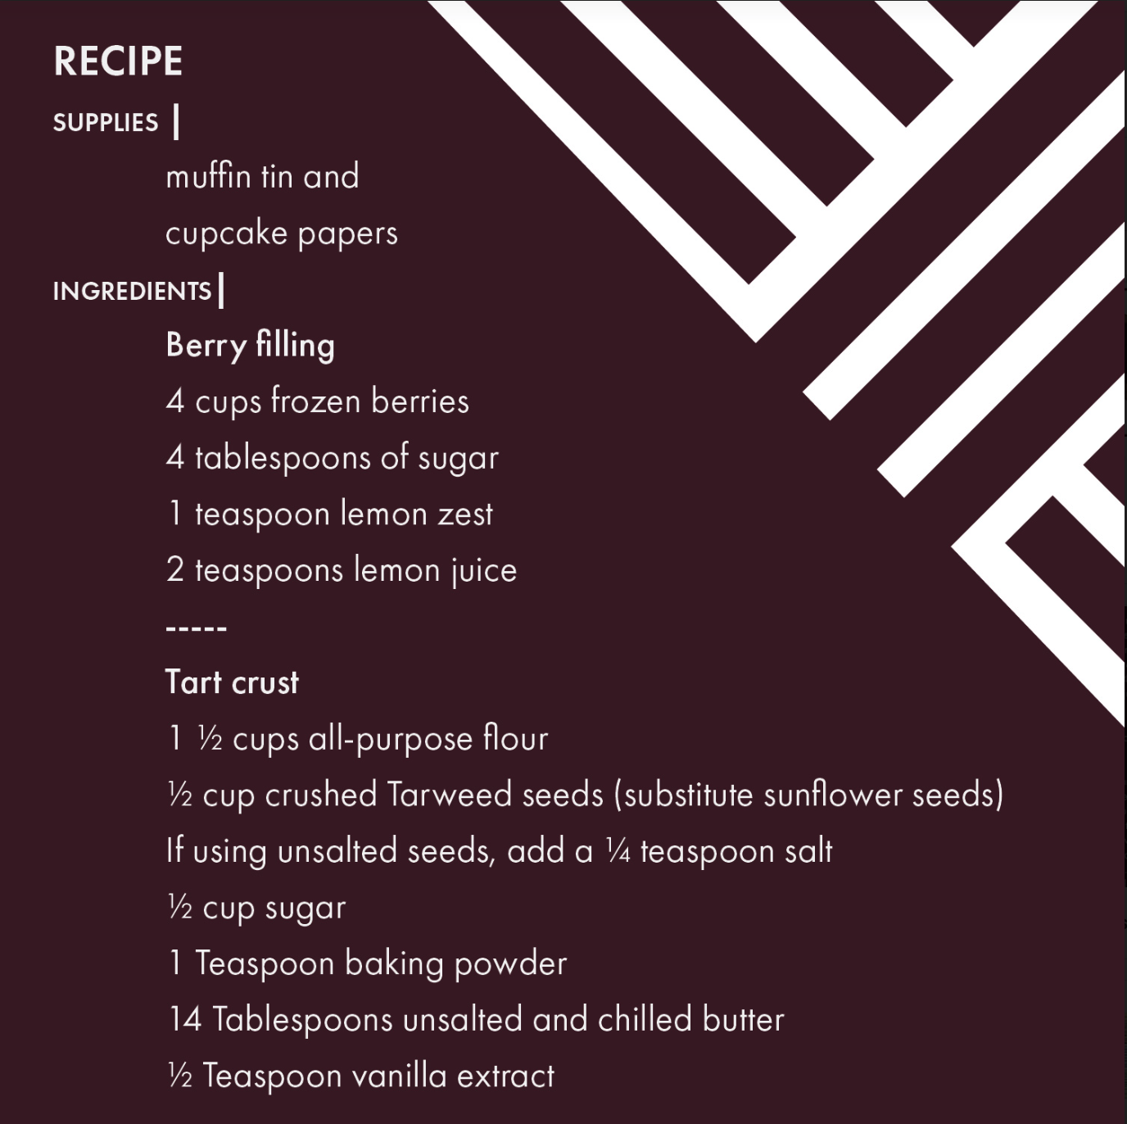
Kalapuya Tart Recipe

Slide 11
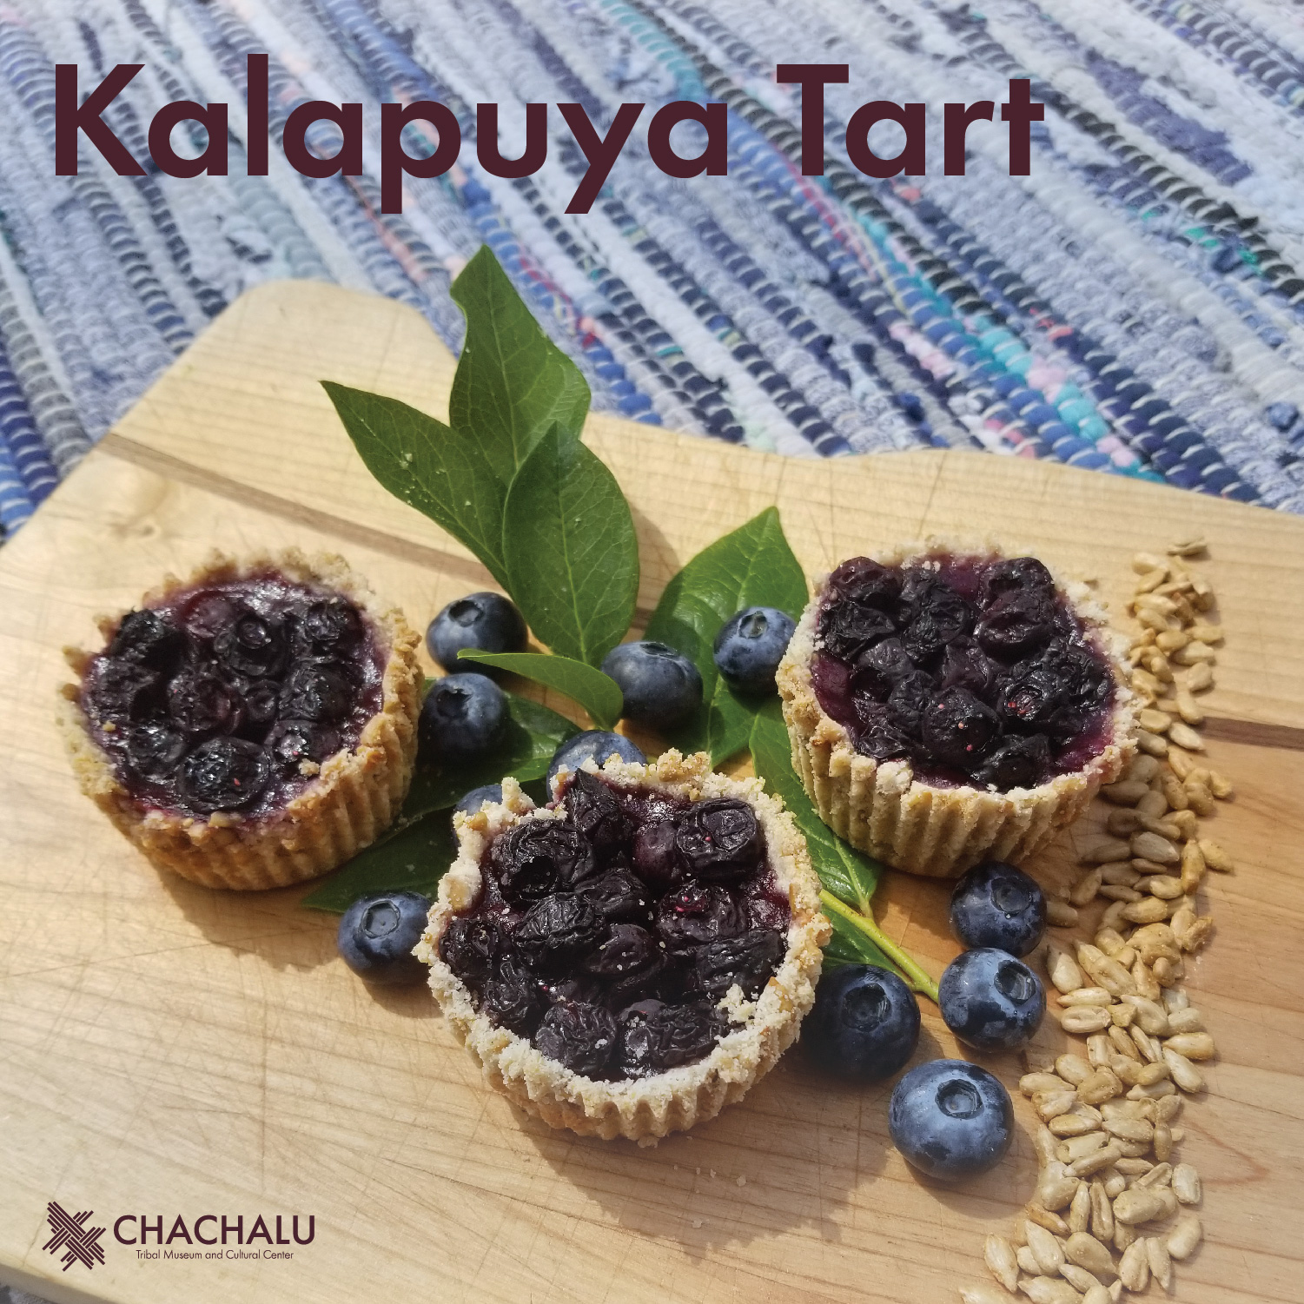

Slide 12
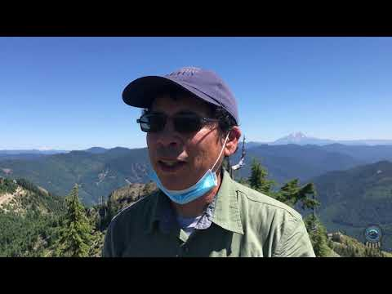
nsayka iliʔi: Cascade Mountains

Slide 13
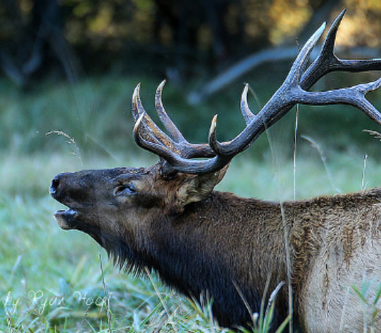
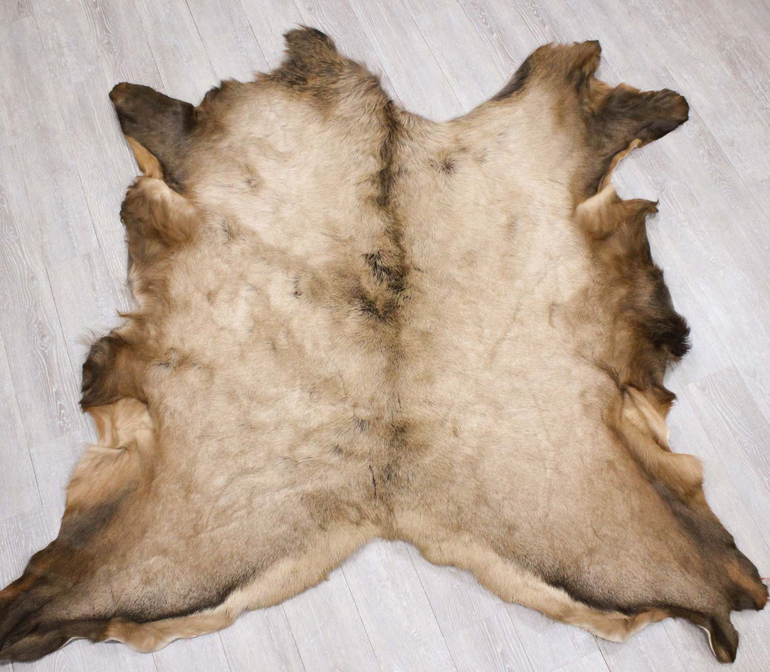
Elk
mulak
Although they were not introduced to Oregon until the early 1900s, elk have become a staple in the diet of many Native families.
Elk are typically harvested in the late fall or early winter.
The meat from elk can be roasted, fried, ground into cakes, and dried. Many tribes serve elk stew as a ceremonial meal for large groups!

Slide 14
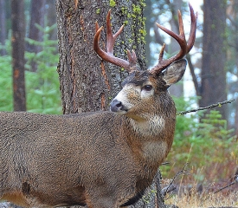
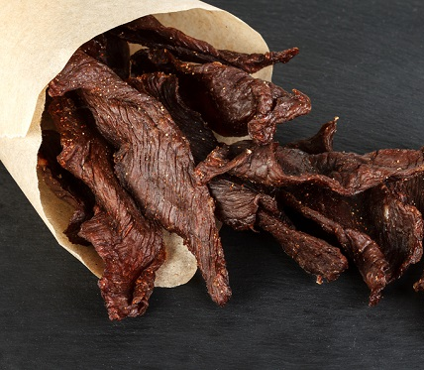
Deer
mawich
Deer have been hunted for thousands of years. The people of the Confederated Tribes of Grand Ronde hunt black-tail deer.
Deer meat, often called venison, contains more fat than elk meat. Many people say it has a stronger, more intense earthy flavor.
Deer are typically harvested in the late summer or fall.
Venison can be roasted, fried, or dried. Many Native families make deer jerky to be eaten all year long (see right).

Slide 15
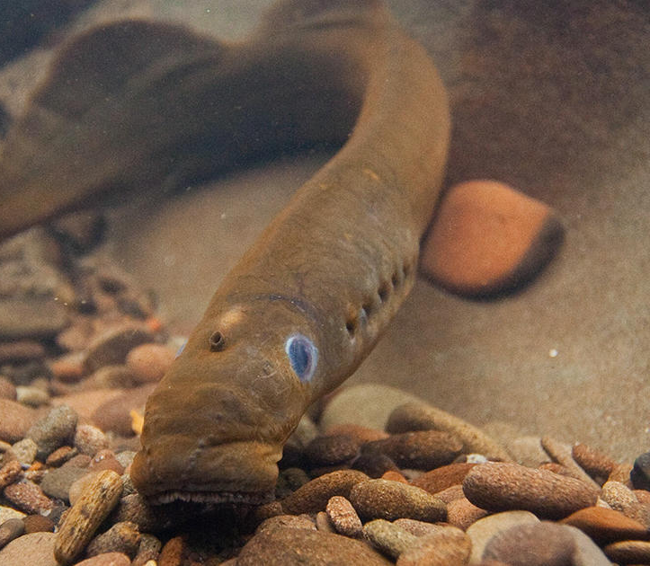
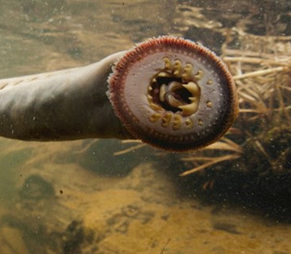
Lamprey
skak^{h}wǝl
Eel or Pacific Lamprey have been an important species to the people of the Confederated Tribes of Grand Ronde since time immemorial.
Pre-reservation, may tribes would travel to different streams and waterfalls to harvest eel for both food and medicinal purposes. Willamette Falls was a significant place for Native peoples to harvest eel, as there was an abundant supply.
Lamprey can be used in stews or dried like jerky.

Slide 16
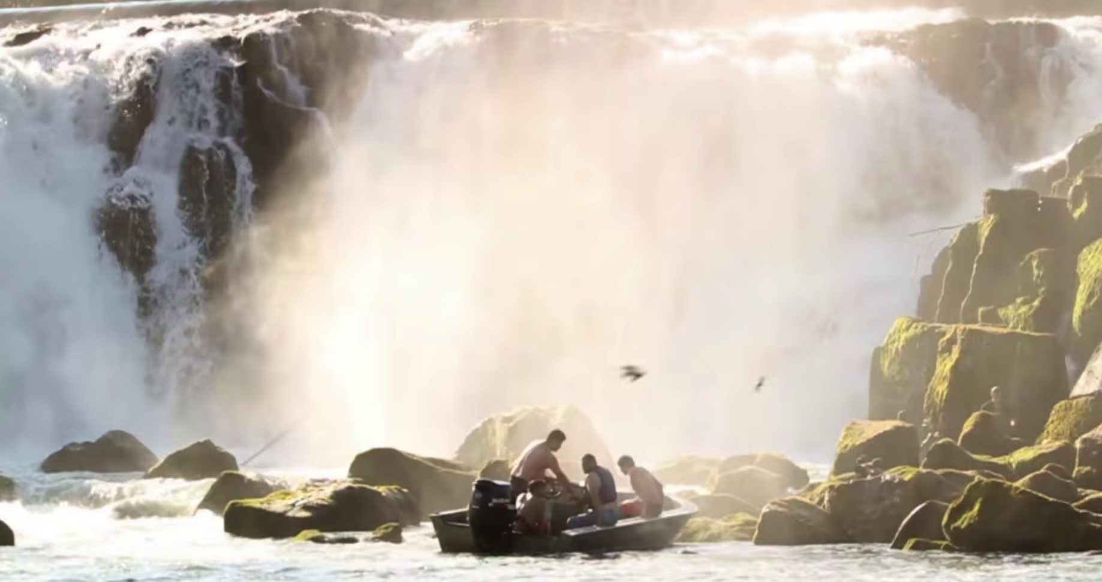
WATCH
Hanging On: Why Pacific Lamprey Matter to Columbia Basin Tribes: https://vimeo.com/53885580

Slide 17
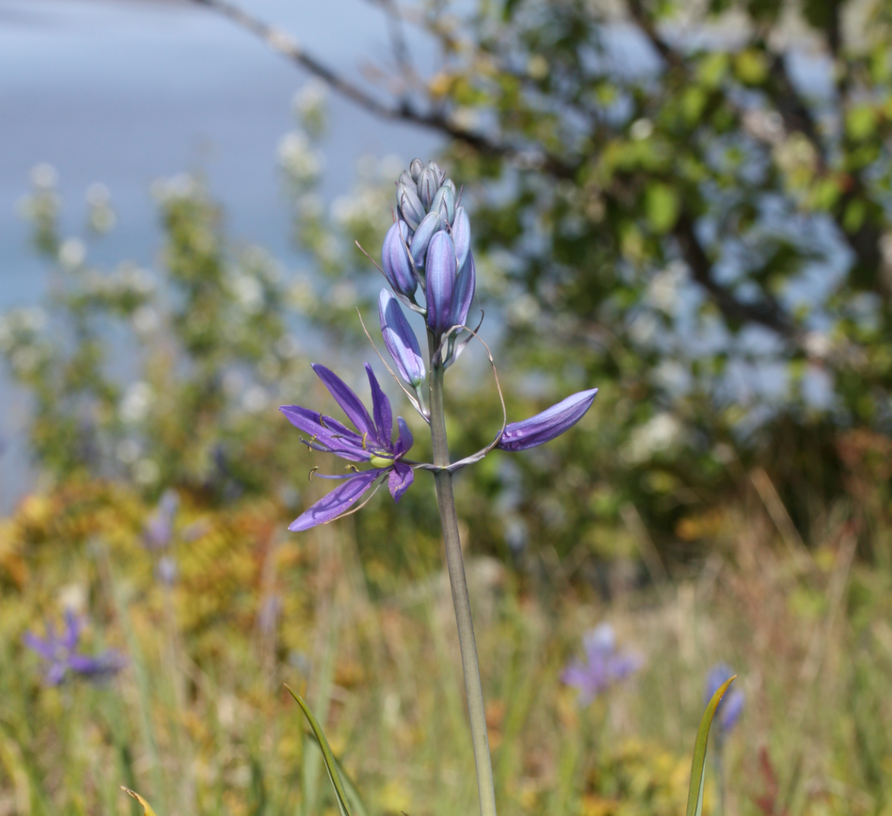
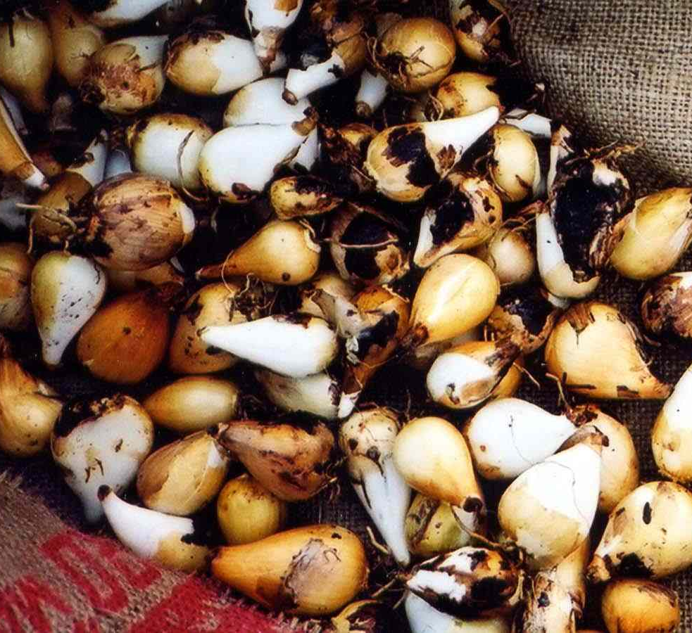
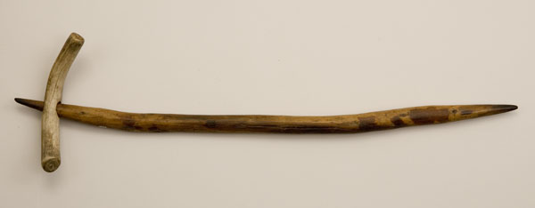
Camas
lakamas
Camas was a main food source for the Native peoples in the Willamette Valley.
It grows in muddy, wet meadows and the bulbs are harvested in the summer using a wooden digging stick.
Camas bulbs were first baked before they could be processed to eat. Bulbs can be eaten immediately out of the earth oven, or they could be made into camas cakes, dried, or combined with other foods.

Slide 18
Additional Resources
Tribe celebrates return of this year's first salmon - Smoke Signals Article
Tribal Government Day honors Native First Foods - Smoke Signals Article
Coho salmon return to Agency Creek - Smoke Signals Video
Grand Ronde returns to the Willamette Falls fishing platform - Smoke Signals Video
The First Fish Celebration - Smoke Signals Video
nsayka munk-smuk kʰapa kʼwənat (We Smoke Salmon) - CTGR Cultural Edu. Video
Coyote Builds Willamette Falls and the Magic Fish Trap - CTGR Traditional Story Video
Coyote and the Fish Trap Recorded in Chinuk Wawa - CTGR Traditional Story Video
Grand Ronde tribes call on Congress to help lift Oregon hunting and fishing restrictions - OPB Article
Thriving Together: Salmon, Berries, and People | Hakai Magazine
Camas.pdf - CTGR Book
Let's Go Eeling.pdf - CTGR Book
People of the Falls - CTGR Video
Home - CTGR Video
CTGR Video Series:
Tribal member Reyn Leno, talks about the consequences of the consent decree
Tribal member Bobby Mercier, on how the consent decree has impacted his family and community.
Tribal member Sara Thompson, the Tribe’s only female ceremonial fisher, speaks to the consent decree

