Slide 1
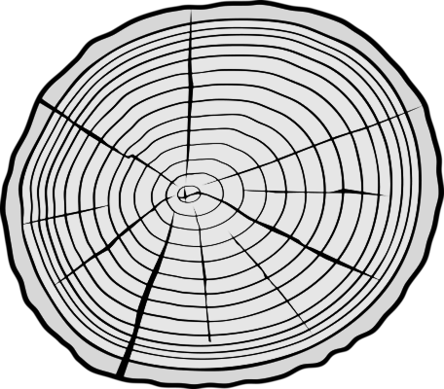
Reforestation
the process, impact, & benefits

Slide 2
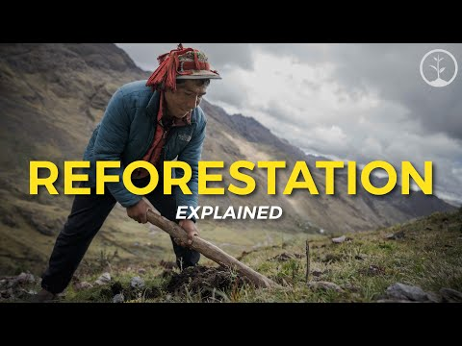

Slide 3
Review Questions
What is deforestation?
What are some of the causes of deforestation?
What is reforestation?
What are some of the reasons for reforestation?
What are the steps of reforestation for the One Tree Planted Organization?
Notes:
What is deforestation? Massive losses of tree cover across the globe
What are some of the causes of deforestation? Industry, agriculture, and worsening wildfires.
What is reforestation? Planting new trees in damaged areas
What are some of the reasons for reforestation? Restoring habitats destroyed by wildfires, replanting former mining and agricultural lands, replenishing areas logged for timber.
What are the steps of reforestation for the One Tree Planted Organization?
Planting location is chosen based on project goals and needs of local communities
Planters choose a tree species for the cite
Trees are orders
Trees are planted
Trees are monitored and maintained

Slide 4
Steps of Reforestation
LOCATION
TREES
ORDERING
PLANTING
MAINTAINING
When locations are determined, several details need to be examined before the first tree is planted to ensure a positive social and environmental impact. This includes assessing the current condition of the land and land use. It also includes preparing the land for the planting process.
After the location is determined, foresters and conservation scientists must determine which trees to plant. Typically, this includes knowledge of plants native to that area and plants that will thrive in the selected location. Scientists must also determine how many trees can be planted in the selected location.
Once the tree species is decided, the trees must be ordered. Seedlings and saplings are ordered in large quantities. Use of seedlings and saplings is more effective than artificial and natural seeding practices.
Seedlings and saplings are planted during effective growing seasons. Planters must also take into consideration the conditions of the land and soil prior to planting- depending on the type of deforestation that took place.
Once the seedlings and saplings are planted, they must still be monitored and maintained to ensure proper growth. This monitoring and maintenance can include weeding, clearing of brush, watering, repairing supports for saplings, and replacing dead/damaged plants.

Slide 5
Benefits
Trees store carbon dioxide in their leaves, trunks, and roots - reducing greenhouse gases
Removes air pollutants
Prevents soil erosion by growing roots that hold the soil together
Provides habitat insects and animals
Reduces the impact of global warming and climate change
Helps to protect endangered species
Filters our drinking water through their roots
Prevents floods and landslides by absorbing water and slowly releasing it via transpiration

Slide 6
Reforestation
at
The Confederated Tribes of Grand Ronde
Silviculture and Fire Protection Program at the Confederated Tribes of Grand Ronde promotes the Tribal tradition of being good stewards of all natural resources by protecting and maintaining forest health and productivity for future use.
Reforestation of land following harvest locations is an important factor in assuring the continuous growth and harvesting of trees.
The Confederated Tribes of Grand Ronde manages and maintains approximately 11,000 acres of land.

Slide 7
Controlled burns and machinery are used to clear extra vegetation and logging debris. This helps to reduce fire hazard, provide room for planting of tree seedlings, lessen initial competition from other vegetation, and limit the cover for seedling damaging rodents
Site Preparation
Methods
Planting seedlings and saplings is the primary method of reforestation on the Reservation. Douglas-fir is the major species planted, comprising 85 to 95 percent of the total trees.
Seed Source
CTGR works with the BLM to obtain seeds from its forest genetics program. The seeds have been genetically controlled for growth, tree form, and resistance to disease.
Monitoring
Improvement activities such as thinning, fertilization, and pruning promote growth and maintain health and productivity.

